Slide 1
BUSINESS ANALYSIS USING FOURSQUARE API and MACHINE LEARNING ALGORITHM using PYTHON
IBM Data Science - Coursera
June, 2019

Slide 2
BUSINESS PROBLEM
One of the biggest challenges for any New York City business is going to be the wide array of competition.
The cost of living is generally high throughout New York state, meaning employees require higher compensation in order to live. It also means the cost of doing business will be higher, as goods and services are significantly steeper than elsewhere.
This project recommends business that are advisable for entrepreneurs to go into and their location.

Slide 3
DATA USED
We extracted the ZIP Code Definitions of New York City Neighborhoods which is available from https://www.health.ny.gov/statistics/cancer/registry/appendix/neighborhoods.htm. Created a csv file and uploaded to own server. To explore and target recommended locations across different venues according to the presence of amenities and essential facilities, we will access data through FourSquare API interface and arrange them as a dataframe for visualization. By merging data on New York City Zip Codes by neighborhood and data on venues and essential facilities surrounding such properties from FourSquare API interface.

Slide 4
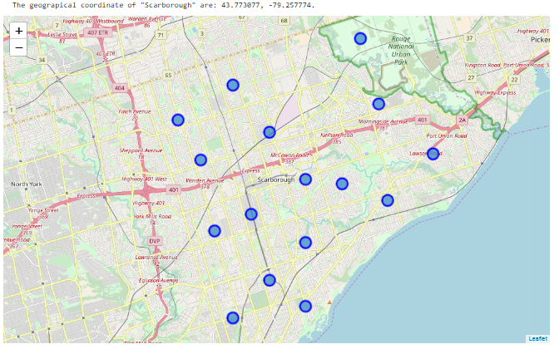
IDENTIFICATION OF NEIGHBORHOOD IN NY

Slide 5
First step is to select the dataset of New York cities neighborhood to be used and read it in CSV data file and we convert into a dataframe.
After finding the list of neighborhoods, we then connect to the Foursquare API to gather information about venues inside each and every neighborhood. These Foursquare calls using the cities name and latitude and longitude values and in return they return venue data. With this new data analysis happens by grouping cities and taking the mean frequency of occurrence of each venue category. This is in preparation of clustering the data.

Slide 6
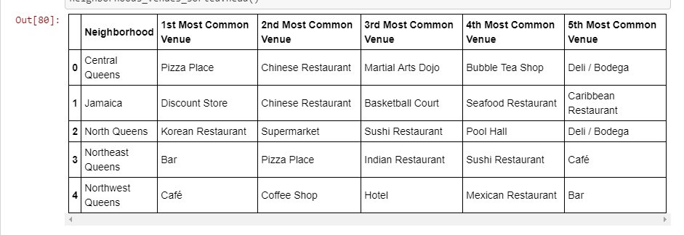
RESULTS

